Slide 1
Windows Registry Analysis
Computer Forensics, 2013

Slide 2
Registry Analysis
Registry is central database of Windows systems
Configuration of system
Information about user activity
applications installed and opened
window positions and sizes
to provide user with a better experience
Information is time-stamped

Slide 3
Registry Analysis
Used to get systems information
Example: System has no prefetch files
Investigate the corresponding registry key
Microsoft knowledge base 307498
HKEY_LOCAL_MACHINE\SYSTEM\CurrentControlSet\Control\Session Manager\Memory Management\PrefetchParameters
Used to establish timelines of activity

Slide 4
Registry Analysis
What if there are no values?
“Absence of evidence is not evidence of absence”
E.g.: Antiforensics: Windows washer removes registry entries
Last runtime of Windows washer becomes evidence
E.g.: Malware dll not loaded through registry
But could be loaded through some other mechanism, such as a shell extension
(Registry remains a popular tool for malware to avoid repeat infections)

Slide 5
Registry Analysis
Contents:
Basic structure remains fixed
Location of values changes
Storage location depends on hive and system
Main hives in Windows\system32\config
Other in system32\config
User information in NTUSER.dat hive in User Profile
Parts are volatile:
Populated when need arises
HKEY_CURRENT_USER, HKEY
HKEY_LOCAL_MACHINE\System
HKEY_CLASSES_ROOT

Slide 6
Registry Analysis
Key Cell Structure
0-3 Size
4-5 Node ID
6-7 Node Type
8-15 LastWrite Time
…
Value Cell Structure
0-3 Size
4-5 Node ID
6-7 Value name length
8-11 Data length
12-15 Offset to data
16-20 Value type

Slide 7
Registry Analysis Tools
Life Analysis
regedit.exe
Native tool (use with caution)
Does not give all information (especially not time of last write)
reg.exe
Native command line tool
Autoruns.exe
Russinovich, SysInternals (now MS) investigates registry and other places for programs that run automatically
Scripting tools
E.g.: Using Perl Win32::TieRegistry

Slide 8
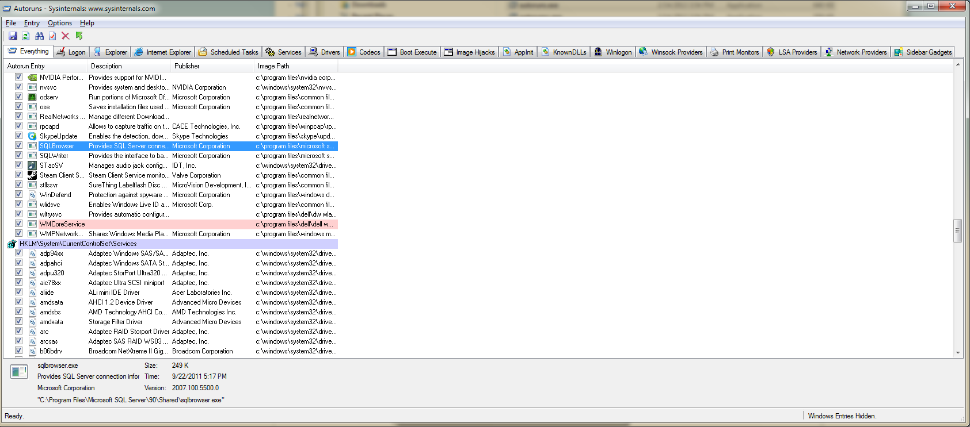
Registry Analysis Tools Autoruns

Slide 9
Registry Analysis Tools
Registry Monitoring
Observe changes to the registry while interacting with system
Regshot
RegMon (SysInternals)

Slide 10
Registry Analysis Tools
Forensics Analysis
Build into tools ProDiscover / Encase, F-Response, FTK
RegRipper, RIP.pl, regslack

Slide 11
Windows XP Registry
Filename | Location | Content
ntuser.dat If there are multiple user profiles, each user has an individual user.dat file in windows\profiles\user account | \Documents and Settings\user account | Protected storage area for user Most Recently Used (MRU) files User preference settings
Default | \Windows\system32\config | System settings
SAM | \Windows\system32\config | User account management and security settings
Security | \Windows\system32\config | Security settings
Software | \Windows\system32\config | All installed programs and their settings
System | \Windows\system32\config | System settings

Slide 12
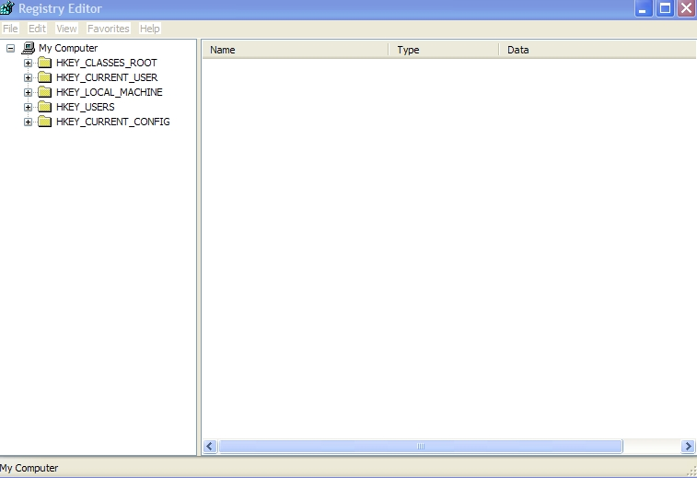
Registry Organization

Slide 13
Windows Security and Relative ID
The Windows Registry utilizes a alphanumeric combination to uniquely identify a security principal or security group.
The Security ID (SID) is used to identify the computer system.
The Relative ID (RID) is used to identity the specific user on the computer system.
The SID appears as:
S-1-5-21-927890586-3685698554-67682326-1005

Slide 14
SID Examples
SID: S-1-0 Name: Null Authority Description: An identifier authority.
SID: S-1-0-0 Name: Nobody Description: No security principal.
SID: S-1-1 Name: World Authority Description: An identifier authority.
SID: S-1-1-0 Name: Everyone Description: A group that includes all users, even anonymous users and guests. Membership is controlled by the operating system.
SID: S-1-2 Name: Local Authority Description: An identifier authority.
SID: S-1-3 Name: Creator Authority Description: An identifier authority.

Slide 15
SID
Security ID
NT/2000/XP/2003
HKLM>SAM>Domains>Accounts>Aliases>Members
This key will provide information on the computer identifier
HKLM>SAM>Domains>Users
This key will provide information in hexadecimal
User ID
Administrator – 500
Guest – 501
Global Groups ID
Administrators – 512
Users – 513
Guest - 514

Slide 16
MRU
To identify the Most Recently Used (MRU) files on a suspect computer system:
Windows 9x/Me
User.dat
Search should be made for MRU, LRU, Recent
Windows NT/2000
Ntuser.dat
Search should be made for MRU, LRU, Recent
Windows XP/2003
HKU>UserSID>Software>Microsoft>Windows>
CurrentVersion>Explorer>RecentDoc
Select file extension and select item

Slide 17
Registry Forensics
Registry keys have last modified time-stamp
Stored as FILETIME structure
like MAC for files
Not accessible through reg-edit
Accessible in binary.

Slide 18
Registry Forensics
Registry Analysis:
Perform a GUI-based live-system analysis.
Easiest, but most likely to incur changes.
Use regedit.
Perform a command-line live-system analysis
Less risky
Use “reg” command.
Remote live system analysis
regedit allows access to a remote registry
Superscan from Foundstone
Offline analysis on registry files.
Encase, FTK (Access data) have specialized tools
regedit on registry dump.

Slide 19
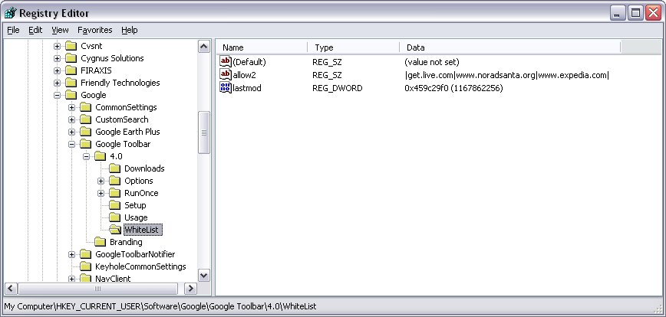
Registry Forensics
Websites

Slide 20
Registry Forensics: NTUSER.DAT
AOL Instant Messenger Away messages
File Transfer & Sharing
Last User
Profile Info
Recent Contacts
Registered Users
Saved Buddy List

Slide 21
Registry Forensics: NTUSER.DAT
ICQ
IM contacts, file transfer info etc.
User Identification Number
Last logged in user
Nickname of user

Slide 22
Registry Forensics: NTUSER.DAT
Internet Explorer
IE auto logon and password
IE search terms
IE settings
Typed URLs
Auto-complete passwords

Slide 23
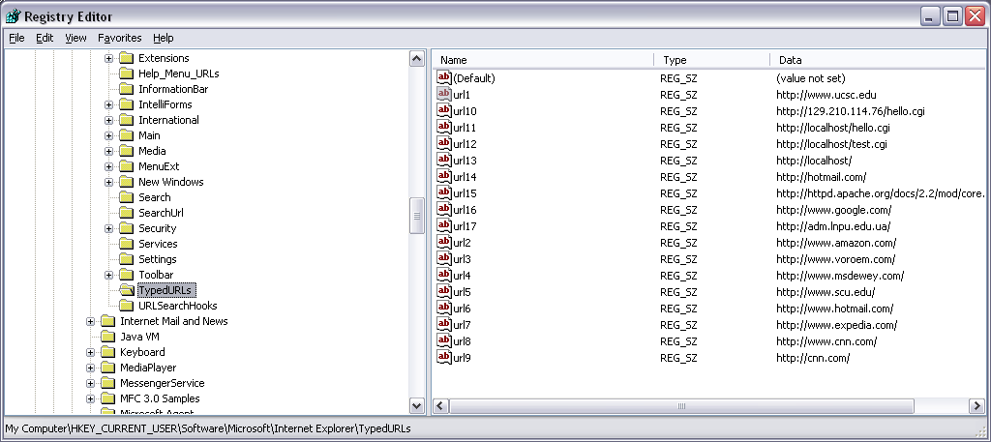
Registry Forensics: NTUSER.DAT IE explorer Typed URLs

Slide 24
Registry Forensics: NTUSER.DAT
MSN Messenger
IM groups, contacts, …
Location of message history files
Location of saved contact list files

Slide 25
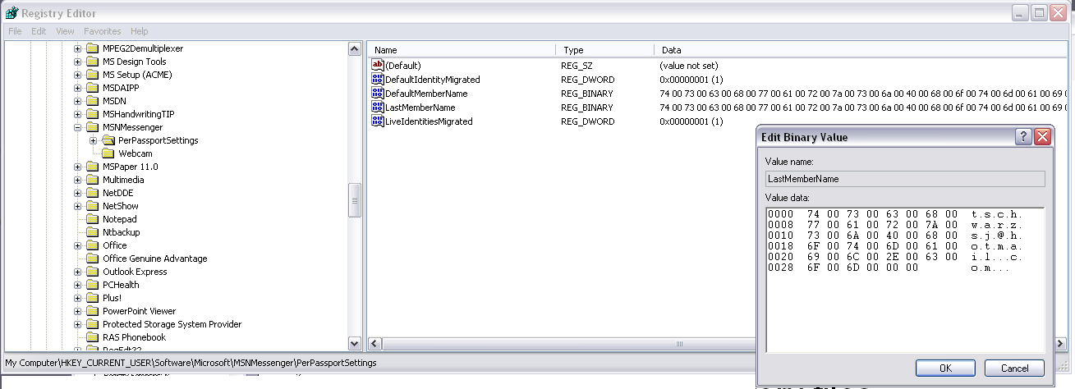
Registry Forensics: NTUSER.DAT Last member name in MSN messenger

Slide 26
Registry Forensics: NTUSER.DAT
Outlook express account passwords

Slide 27
Registry Forensics
Yahoo messenger
Chat rooms
Alternate user identities
Last logged in user
Encrypted password
Recent contacts
Registered screen names

Slide 28
Registry Forensics
System:
Computer name
Dynamic disks
Install dates
Last user logged in
Mounted devices
Windows OS product key
Registered owner
Programs run automatically
System’s USB devices

Slide 29
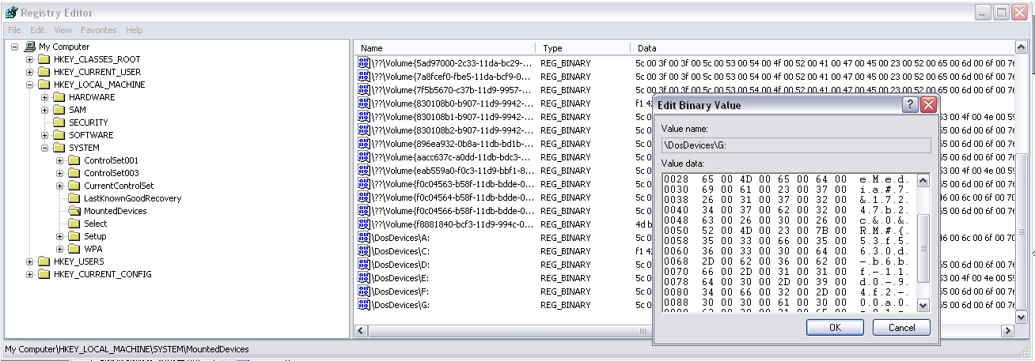
Registry Forensics

Slide 30
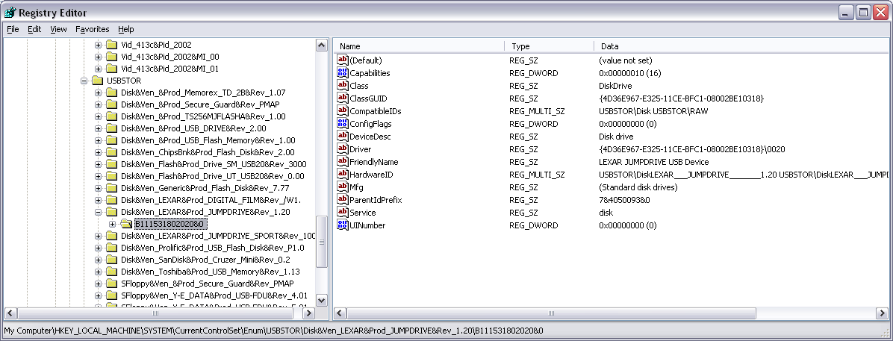
Registry Forensics USB Devices

Slide 31
Registry Forensics
Networking
Local groups
Local users
Map network drive MRU
Printers

Slide 32
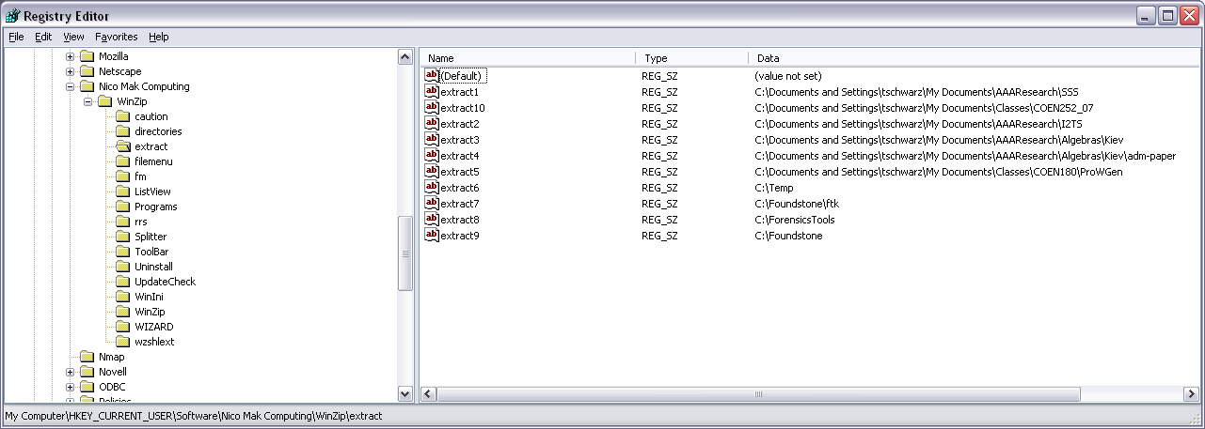
Registry Forensics Winzip

Slide 33
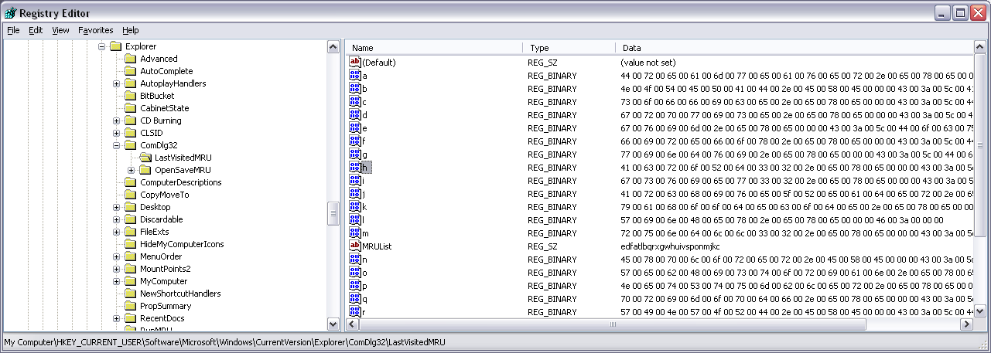
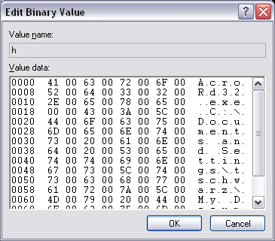
Registry Forensics
List of applications and filenames of the most recent files opened in windows

Slide 34
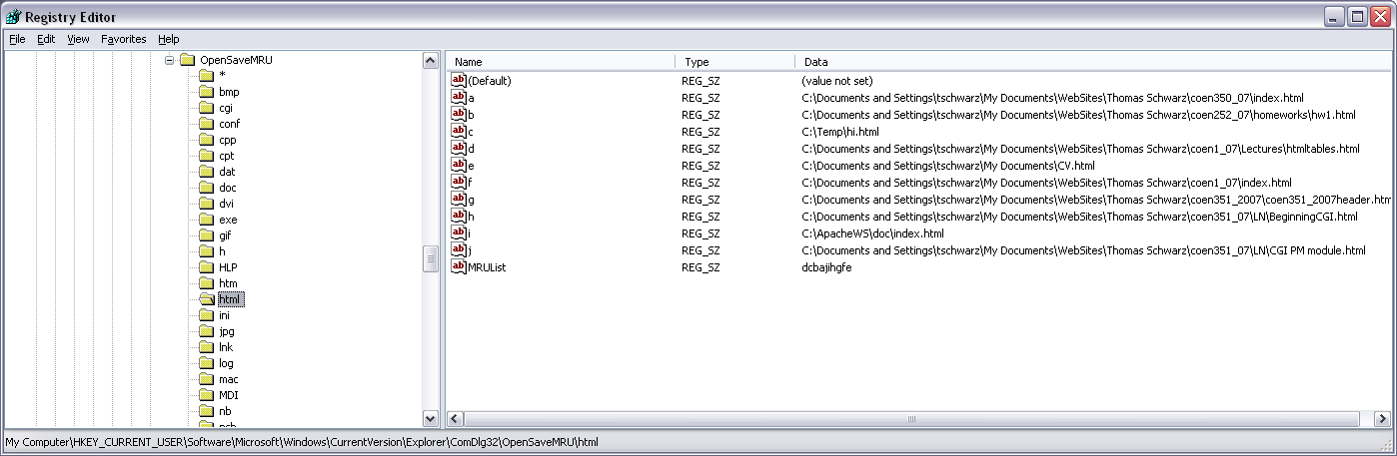
Registry Forensics
Most recent saved (or copied) files

Slide 35
Registry Forensics
System
Recent documents
Recent commands entered in Windows run box
Programs that run automatically
Startup software
Good place to look for Trojans

Slide 36
Registry Forensics
User Application Data
Adobe products
IM contacts
Search terms in google
Kazaa data
Windows media player data
Word recent docs and user info
Access, Excel, Outlook, Powerpoint recent files

Slide 37
Registry Forensics
Go to
Access Data’s Registry Quick Find Chart

Slide 38
Registry Forensics
Case Study
(Chad Steel: Windows Forensics, Wiley)
Department manager alleges that individual copied confidential information on DVD.
No DVD burner was issued or found.
Laptop was analyzed.
Found USB device entry in registry:
PLEXTOR DVDR PX-708A
Found software key for Nero - Burning ROM in registry
Therefore, looked for and found Nero compilation files (.nrc). Found other compilation files, including ISO image files.
Image files contained DVD-format and AVI format versions of copyrighted movies.
Conclusion: No evidence that company information was burned to disk. However, laptop was used to burn copyrighted material and employee had lied.

Slide 39
Registry Forensics
Intelliform:
Autocomplete feature for fast form filling
Uses values stored in the registry
HKEY_CURRENT_USER\Software\Microsoft\Protected Storage System Provider
Only visible to SYSTEM account
Accessible with tools such as Windows Secret Explorer.

Slide 40
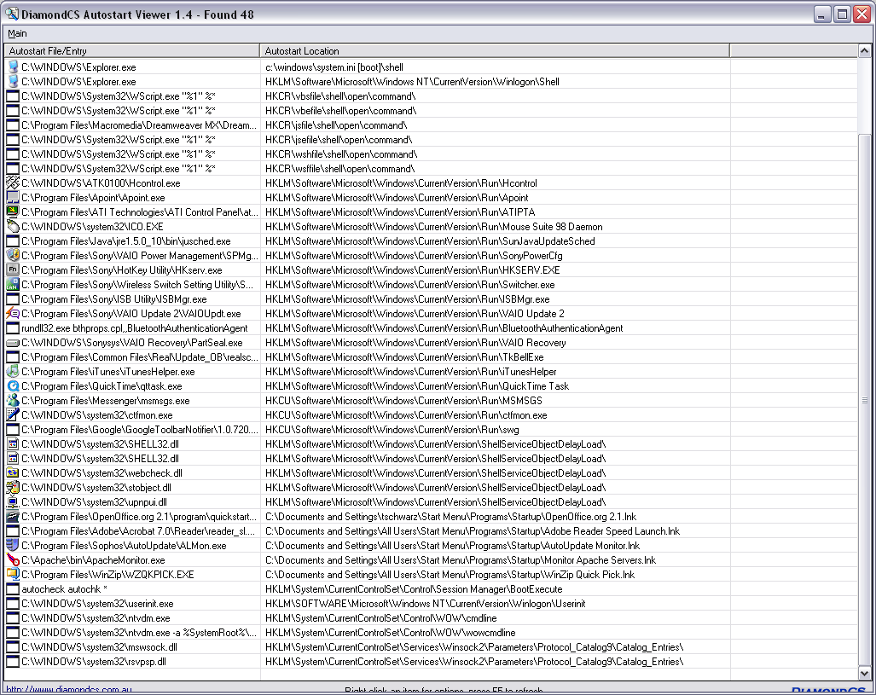
Registry Forensics: AutoStart Viewer (DiamondCS)

Slide 41
Registry Research
Use REGMON (MS Sysinternals) to monitor changes to the registry
Registry is accessed constantly
Need to set filter
Or enable Regmon’s log boot record
Captures registry activity in a regmon file
Do it yourself: Windows API
RegNotifyChangeKeyValue
Many commercial products
DiamondCS RegProt
Intercepts changes to the registry

Slide 42
Registry Forensics Investigation
Forensics tools allow registry investigation from image of drive
Differences between life and offline view
No HARDWARE hive (HKLM)
Dynamic key, created at boot
No virtual keys such as HKEY_CURRENT_USER
Derived from SID key under HKEY_USERS
Source file is NTUSER.DAT
Do not confuse current and repair versions of registry files
%SystemRoot%\system32\config (TRUE registry)
%SystemRoot%\repair (repair version of registry)

Slide 43
Registry Forensics Investigation
Forensics search can reveal backups of registry
Intruders leave these behind when resetting registry in order not to damage system

Slide 44
Registry Forensics Investigation
Time is Universal Time Coordinated
a.k.a. Zulu
a.k.a Greenwhich Time

Slide 45
Registry Forensics Investigation
Software Key
Installed Software
Registry keys are usually created with installation
But not deleted when program is uninstalled
Find them
Root of the software key
Beware of bogus names
HKEY_LOCAL_MACHINE\SOFTWARE\Microsoft\Windows\CurrentVersion\App Paths
HKEY_LOCAL_MACHINE\SOFTWARE\Microsoft\Windows\CurrentVersion\Uninstall
If suspicious, use information from the registry to find the actual code
Registry time stamps will confirm the file MAC data or show them to be altered

Slide 46
Registry Forensics Investigation
Software Key
Last Logon
HKEY_LOCAL_MACHINE\SOFTWARE\Microsoft\Windows NT\CurrentVersion\WinLogon
Logon Banner Text / Legal Notice
HKEY_LOCAL_MACHINE\SOFTWARE\Microsoft\Windows NT\CurrentVersion\WinLogon
Security Center Settings
HKEY_LOCAL_MACHINE\SOFTWARE\Microsoft\Security Center
HKEY_LOCAL_MACHINE\SYSTEM\CurrentControlSet\Services\SharedAccess\Parameters\FirewallPolicy
If firewall logging is enabled, the log is typically at %SystemRoot%/pfirewall.log

Slide 47
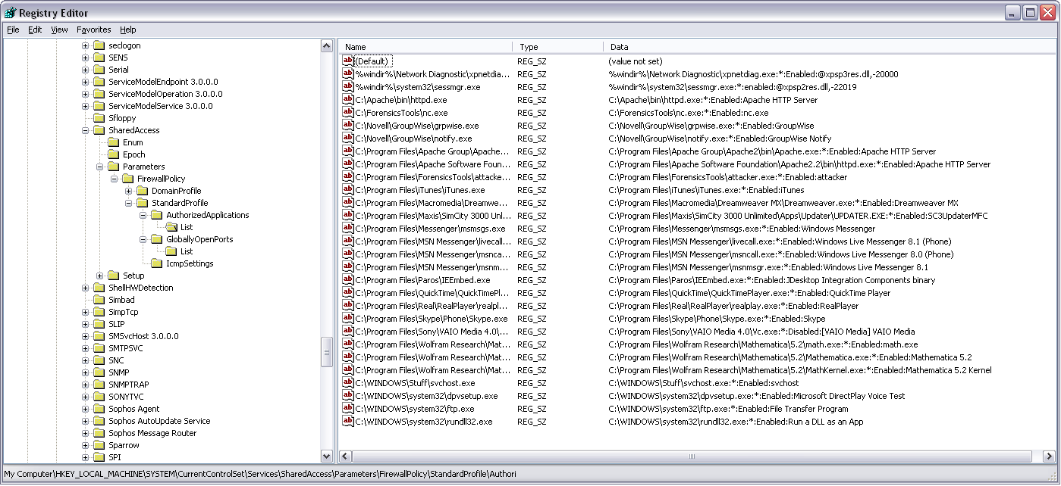
Registry Forensics Investigation

Slide 48
Registry Forensics Investigation
Analyze Restore Point Settings
Restore points developed for Win ME / XP
Restore point settings at
HKEY_LOCAL_MACHINE\SOFTWARE\Microsoft\Windows NT\CurrentVersion\SystemRestore
Restore points created every RPGlobalInterval value seconds (~every 24h)
Retention period is RPLifeInterval seconds (default 90 days)
Restore point taking in ON by default
Restore points in System Volume Information\restore…

Slide 49
Registry Forensics Investigation
Aside: How to access restore points
Restore points are protected from user, including administrator
Administrator can add her/himself to the access list of the system volume directory
Turn off “Use simple file sharing” in Control Panel → Folder Options
Click on “Properties” of the directory in Explorer and

Slide 50
Registry Forensics Investigation
Restore point
makes copies of important system and program files that were added since the last restore points
Files
Stored in root of RP### folder
Names have changed
File extension is unchanged
Name changes kept in change.log file
Registry data
in Snapshot folder
Names have changed, but predictably so

Slide 51
Registry Forensics Investigation
SID (security identifier)
Well-known SIDs
SID: S-1-0 Name: Null Authority
SID: S-1-5-2 Name: Network
S-1-5-21-2553256115-2633344321-4076599324-1006
S string is SID
1 revision number
5 authority level (from 0 to 5)
21-2553256115-2633344321-4076599324 domain or local computer identifier
1006 RID – Relative identifier
Local SAM resolves SID for locally authenticated users (not domain users)
Use recycle bin to check for owners

Slide 52
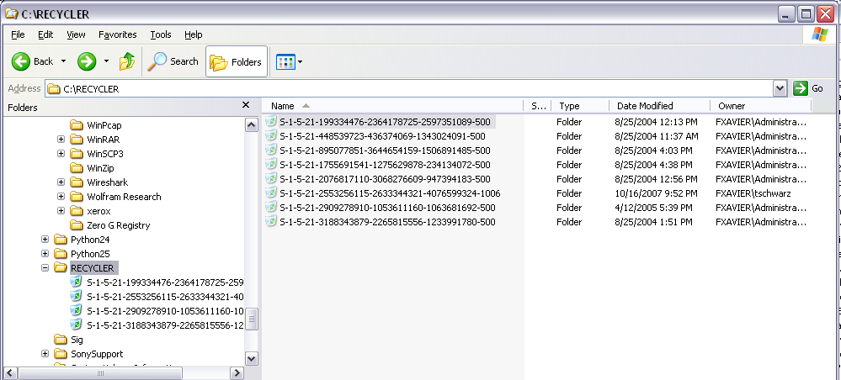
Registry Forensics Investigation
Resolving local SIDs through the Recycle Bin
(life view)

Slide 53
Registry Forensics Investigation
Protected Storage System Provider data
Located in NTUSER.DAT\Software\Microsoft\ Protected Storage System Provider
Various tools will reveal contents
Forensically, AccessData Registry Viewer
Secret Explorer
Cain & Abel
Protected Storage PassView v1.63

Slide 54
Registry Forensics Investigation
MRU: Most Recently Used
HKEY_CURRENT_USER\SOFTWARE\Microsoft\Windows\CurrentVersion\Exlorer\RunMRU
HKEY_CURRENT_USER\SOFTWARE\Microsoft\Windows\CurrentVersion\Exlorer\Map Network Drive MRU
HKEY_CURRENT_USER\Printers\Settings\Wizard\ConnectMRU
HKEY_CURRENT_USER\SOFTWARE\Microsoft\Windows\CurrentVersion\Exlorer\ComDlg32
Programs and files opened by them
Files opened and saved
HKEY_CURRENT_USER\SOFTWARE\Microsoft\Search Assistant\ACMru

Slide 55
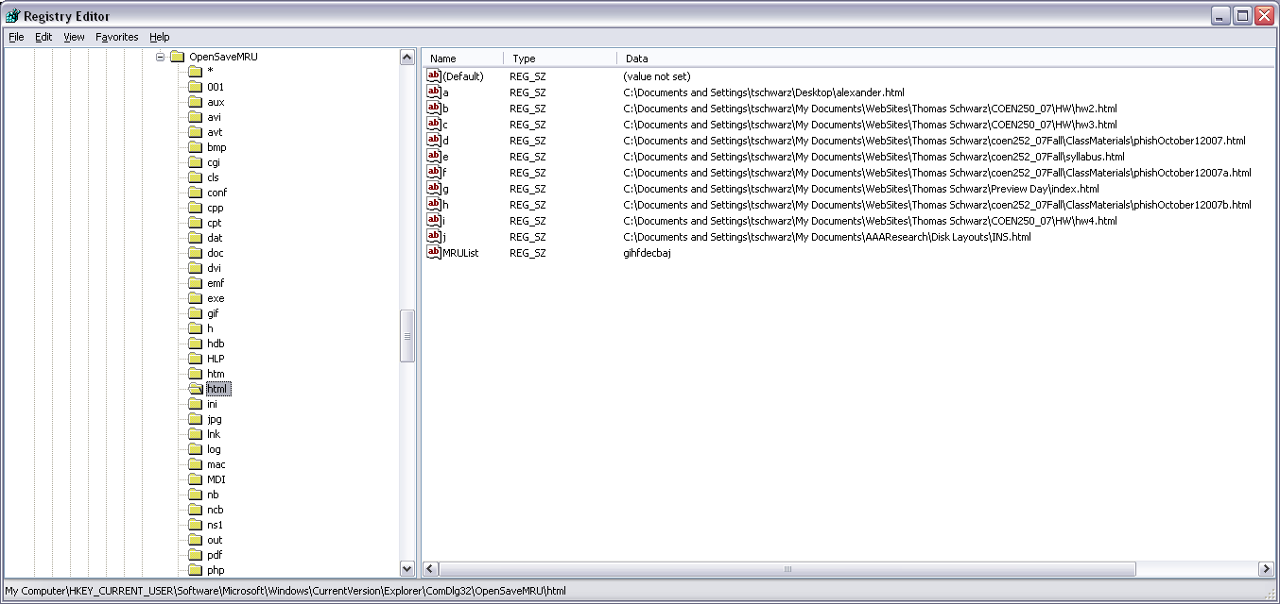
Registry Forensics Investigation

Slide 56
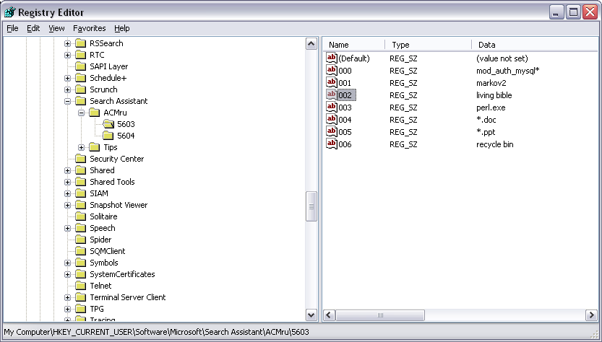
Registry Forensics Investigation

Slide 57
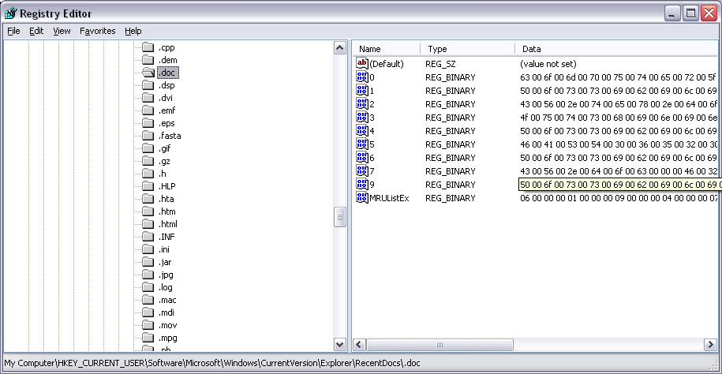
Registry Forensics Investigation

Slide 58
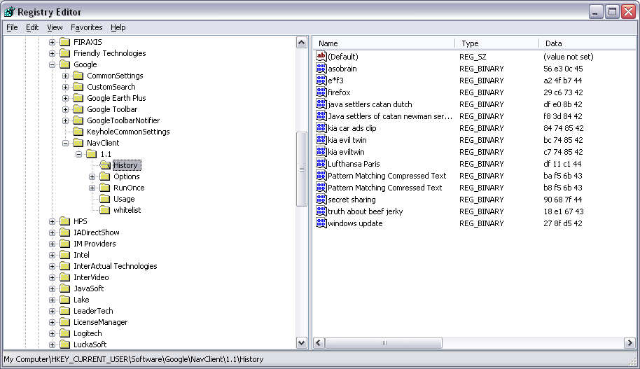
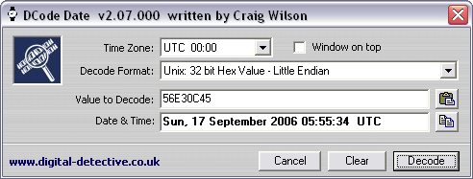
Registry Forensics Investigation

Slide 59
Registry Forensics Investigation
HKEY_CURRENT_USER\SOFTWARE\Microsoft\Windows\CurrentVersion\Exlorer\UserAssist\{*********}\Count
ROT-13 encoding of data used to populate the User Assist Area of the start button
Contains most recently used programs

Slide 60
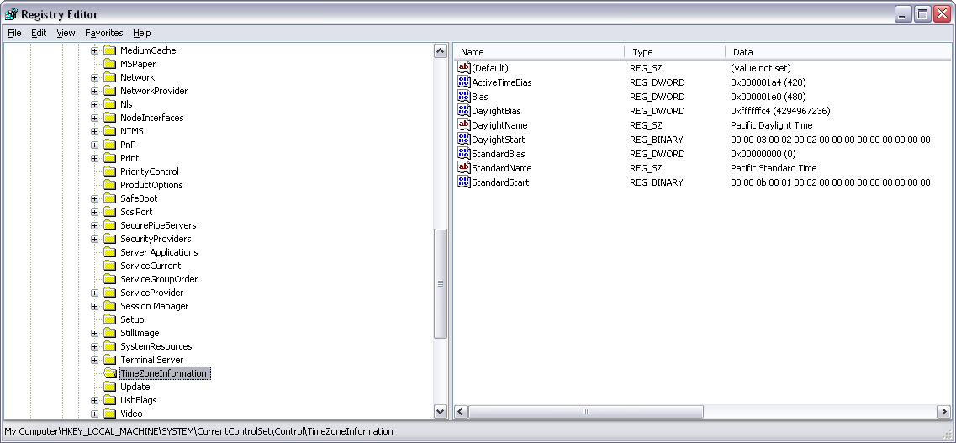
Registry Forensics Investigation

Slide 61
Registry Forensics Investigation
AutoRun Programs
Long list of locations in registry
Long list of locations outside the registry
SystemDrive\autoexec.bat
SystemDrive\config.exe
Windir\wininit.ini
Windir\winstart.bat
Windir\win.ini
Windir\system.ini
Windir\dosstart.bat
Windir\system\autoexec.nt
Windir\system\config.nt
Windir\system32\autochk.exe

Slide 62
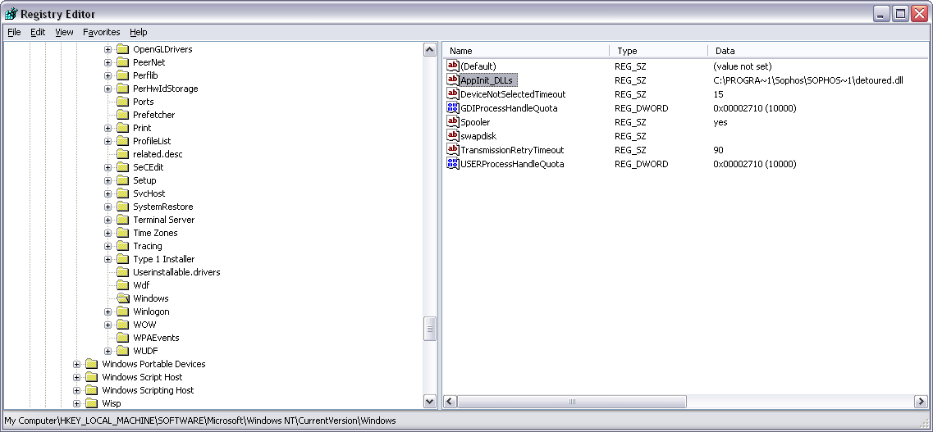
Registry Forensics Investigation
Rootkit Enabler
Attacker can use AppInit_DLL key to run own DLL.

